Slide 1
Communication and Types of Communication
Stephen Muthoga

Slide 2
*Explain to fellows that communication is more powerful today than ever before as it has overwhelming influence on human behavior change
*Ask fellows to brainstorm on what the term ‘communication’ means and share with them the definitions provided in section .

Slide 3
Communication
Communication is a core aspect in human interaction and therefore, plays a key role in moulding and influencing human behavior including health-seeking behavior. Skills in effective communication by health care providers is crucial for successful delivery of public health services and especially so in designing and managing implementation OF HEALTH PROGRAMMES. In other words, good communicators are more likely to be adjudged as effective public health programmes managers.

Slide 4
Communication is a series of experiences based on
Hearing
Smell
Taste
Touch
Sight

Slide 5
Goals of Communication
To change behavior
To get action
To ensure understanding
To persuade
To get and give information

Slide 6

Objectives:
At the end of this lesson, fellows will be able to:
Define communication
Explain the basic elements of communication
Discuss some key theories and models of communication
Discuss the 7cs of effective communication

Slide 7
COMMUNICATION AND TYPES OF COMMUNICATION
1. Communication can simply be defined as the process of originating, expressing, transmitting, receiving and responding to information relating to human thoughts/ feelings about certain issues through verbal or non-verbal means aimed at mutual understanding
2. Communication is a process of exchanging:
information
ideas, thoughts, feelings and emotions
through speech, signals, writing, or behavior.

Slide 8
Definitions cont.
3. Communication can also be defined as the process of originating, expressing, transmitting, receiving and responding to information relating to human thoughts/ feelings about certain issues through verbal or non-verbal means aimed at mutual understanding. At times, communication is seen as a process through which humankind can either “cause” or “solve” problems

Slide 9

Quick Question:
WHAT WOULD MAKE YOUR AUDIENCE/CLIENTS ACCEPT OR BE ATTRACTED TO YOUR MESSAGE?

Slide 10
Characteristics of effective messages:
Command attention
Cater for the heart and head
Clarify the message
Communicate a benefit
Create trust
Call for action
Consistency counts

Slide 11

Note:
Maximizing the impact of communication intervention begins with effective message design; the number of people affected at each step of the hierarchy of effects can be increased through effective messages for example:
More audience may notice your message or be exposed to the message if you command attention
More of the intended audience may correctly understand your message if you clarify the message and the message is consistent

Slide 12
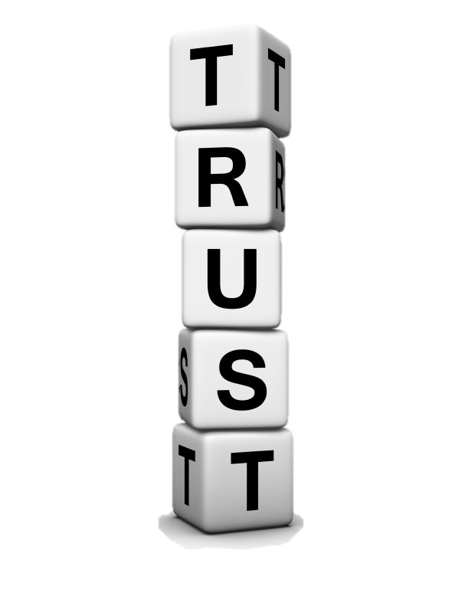
Note:
More of the intended audience may agree with your message if you communicate the benefit to them and you cater to their heart and head their emotion and rational thinking
More of the intended audience may intend to take action if you create a sense of trust
More of your audience may act if you let them know what to do or call them to action

Slide 13
Types of Communication
Communication in organization can be studied under :
Channel or Network :
Formal
Informal.
Direction of Message :
Downward
Upward
Horizontal
4)Diagonal
Method of Expression :
Oral
Written
Gestural

Slide 14
Types cont.
Verbal Communication
Nonverbal Communication
NOTE:
Choice of communication channel and your style of communicating affects communication.
Types:
1. Intra-personal communication - thinking and talking to oneself.
2. Interpersonal communication - two individuals.
3. Group communication - an individual with other several people in close physical proximity.
4. Mass communication - communication-a communicator with (either in single or group) large numbers of people using a mass medium such as newspapers, books, magazines, television, radio etc..

Slide 15

Channels of Communication
Formal Communication
It refers to the official communication which takes place following the chain of command in the organization.

Slide 16
Advantages of Formal Communication
Orderly Flow of Information
identified Source
Control
Answerability for Actions
Justification of authority
Authentic Information

Slide 17
Disadvantages of Formal Communication
Time consuming
Lack of Personal Touch
Distortion
Expensive

Slide 18
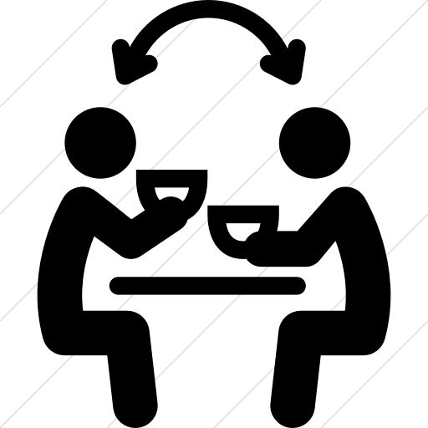
Informal Communication
Communication between individuals and groups which are not officially recognized.

Slide 19
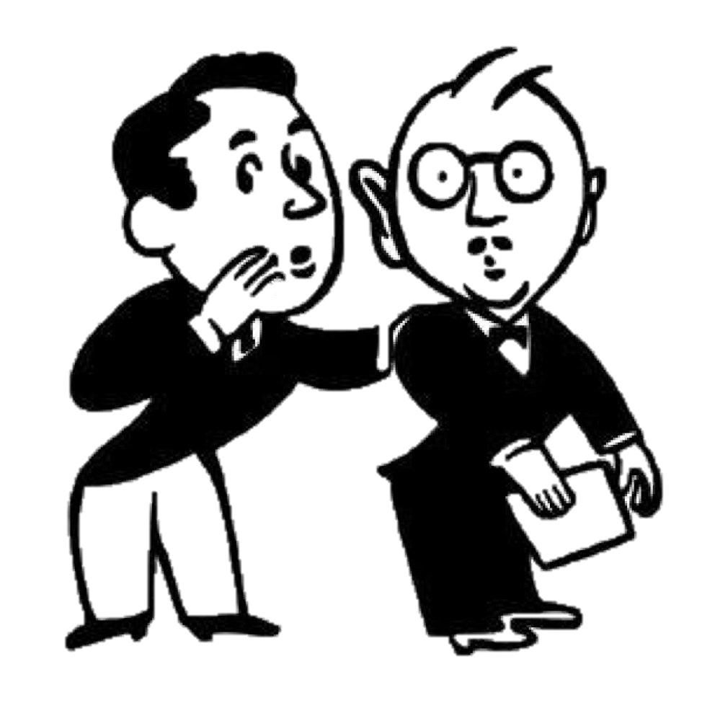
Types of Informal Communication
Single Strand Network
Gossip Network
Probability network
Cluster
Rumors

Slide 20
Grapevine has the following features
It transmits in every direction
Grapevine is selective with regard to the person who receives the information.
Grapevine is based on people rather than task.
Grapevine does not follow a fixed pattern.
Grapevine generally occurs orally.
Grapevine extends beyond the formal hierarchy system of an organization. It can occur off the job.

Slide 21

Advantages of Informal Communication
Social Relations
Need satisfaction
Speed
Feedback
Better Human Relations

Slide 22

Disadvantages of Informal Communication
lncomplete Information
Distortion
Unreliability
Lack of Authenticity
Problem in Fixing Responsibility

Slide 23

Direction or Flow of Communication
Downward communication
Upward communication
Horizontal communication
Diagonal communication

Slide 24
Types of Communication
Communication can be divided into verbal and non verbal.
Verbal communication means any communication that involves spoken words or sounds.
Non verbal communication includes any communication that does not use oratory media for communication.

Slide 25
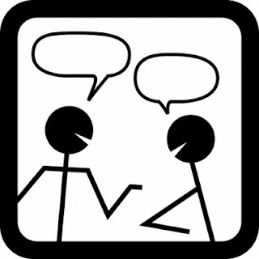
Verbal Communication
Communication is done by word of mouth and a piece of writing
In verbal communication remember the acronym KISS(keep it short and simple)
Verbal Communication is further divided into:
Oral Communication
Written Communication

Slide 26
Oral Communication
Spoken words are used
It includes face-to-face conversations, speech, telephonic conversation, video, radio, television, voice over internet. This type of communication is influenced by, pitch, volume, speed and clarity of speaking.

Slide 27
Skills Required for Oral Presentation
For a good oral presentation, the quality of text being prepared and the way it is presented are equally important.
An organized text presentation allows the orator to proceed smoothly from point-to-point. Presenting relevant data through the presentation is first and foremost point to be kept in the mind. speech/presentation should be interactive. Individual and business relations can be developed and maintained with the help of these skills.

Slide 28
Oral Communication
Advantages
Disadvantages
Time - saving device
Interaction
Ample scope
Economic in nature
Feedback
Lack of time
Lack of legal validity
Misunderstanding
Effectiveness
Retained in record books

Slide 29
Written Communication
Message can be transmitted via email, letter, report, memo etc.
Message, in written communication, is influenced by the vocabulary & grammar used, writing style, precision and clarity of the language used

Slide 30
Importance of Written Communication
It helps in maintaining records of business transactions.
Written communication like brochures and catalogs help companies t showcase their products effectively.
Print advertisements help to market products.
Written documents can serve as evidence in a court of law if and when required.
Written words are believed more than spoken words. It's just human psychology to believe something that we see in writing than something someone says
Personal written communication like letters, emails, post cards, greeting cards, etc., have their own charm and special meaning to the ones sending and receiving them.

Slide 31

How to Improve Written Communication Skills:
Audience
Information
Tone
Length
Notes:
Audience: Once you have an idea about who is the intended audience, you can judge for yourself what other necessary steps need to be taken to ensure the completion of the communication cycle, which is, after all, the intention of any piece of communication.
Information: The basics of communication should be covered in your piece of written communication. This is basically almost the entire information that you wish to give the reader. However you present the data, these points need to covered, only then is it an effective way of communication.
Tone: Deciding the tone of your communication depends on the audience to a large extent Tones can vary from casual, semi formal to formal, depending on who you're communicating with and what intend to communicate.
Length: Knowing when to stop to communication skills as well. You cant just keep ramblng on—a... and on, when not required. The beauty of effective written communication can be seen in its presentation. How wel and how concise you manage to accommodate all the information that you need to give is what shows how proficient your written communicaion skills are. The key is to be 'clear, concise and correct'. But this does not necessarily mean that you cut short on something that requires to be explained in detail.

Slide 32
Nonverbal Communication
This is the sending or receiving of wordless messages such as gesture, body language, posture, tone of voice or facial expressions. Nonverbal communication is all about the body language of speaker. Sometimes nonverbal response contradicts verbal communication and hence affect the effectiveness of message.

Slide 33
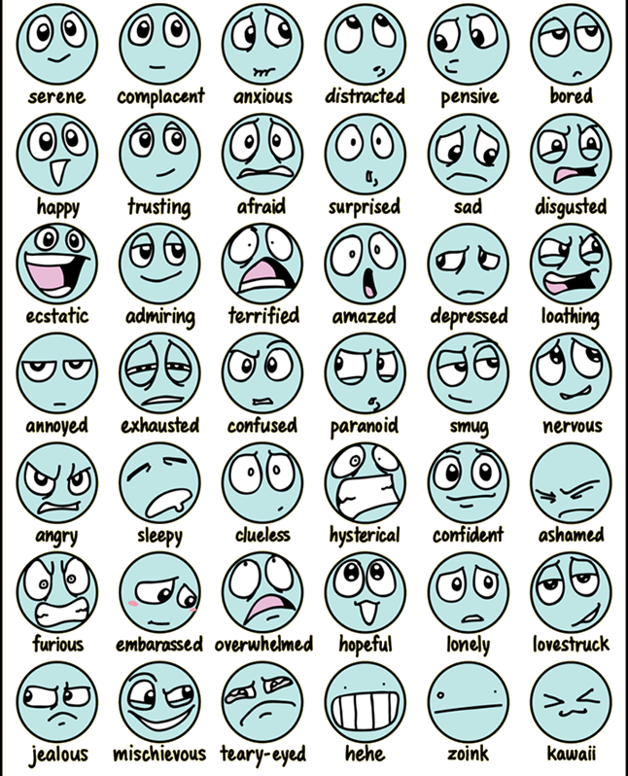
Non-verbal communication
Through signs & symbols.
Non-verbal can go without verbal communication.
Verbal can't go without non-verbal communication

Slide 34
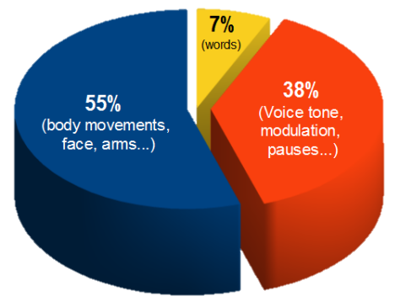
Conveyance ratios of a Message:

Slide 35
Types of Non-verbal communication
Kinesics (body language)
Haptics (touch language)
Proxemics language)
Artifacts environmental
Chronemics (time language)
Silence
Sign
Paralanguage\Vocalic

Slide 36
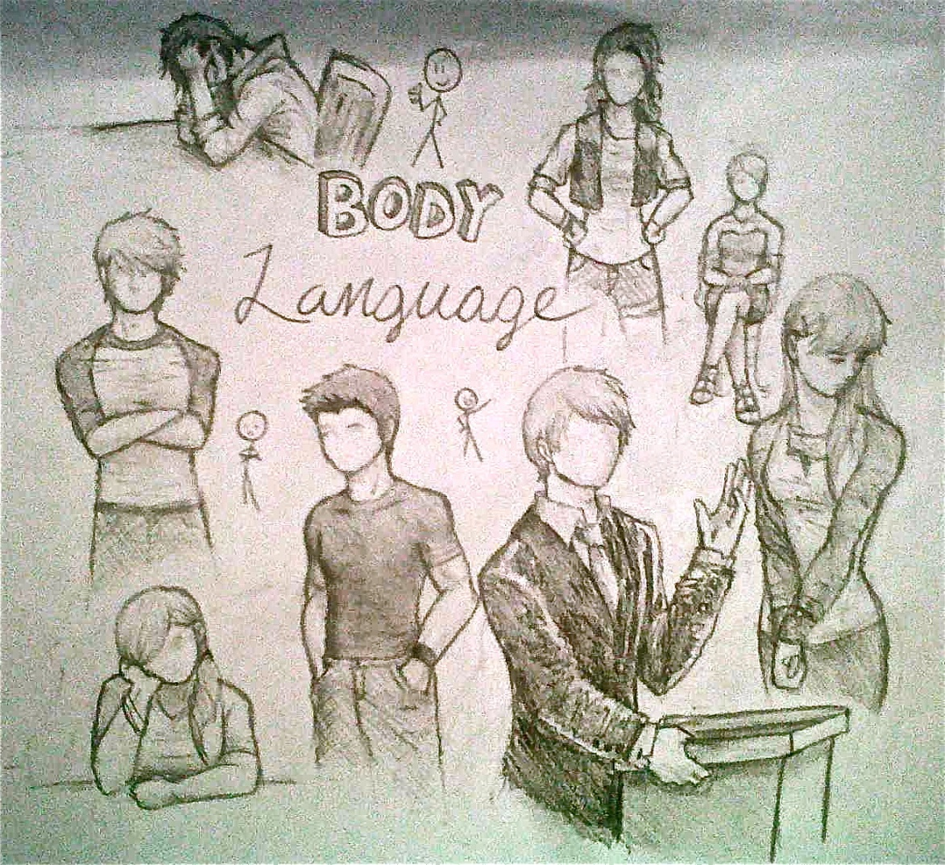
KINESICS (BODY LANGUAGE)
Facial expression
Head
Eye gaze
Gestures
Postures
Shape of body
Personal appearance adornment
Notes:
FACIAL EXPRESSION Face is the index of mind. Think how much information can be conveyed with a smile or a non frown. By facial expressions we can show or we can understand happiness, sadness, anger and fear and much more

Slide 37

Haptics (Touch Language)
This has to do with communication via touch.

Slide 38
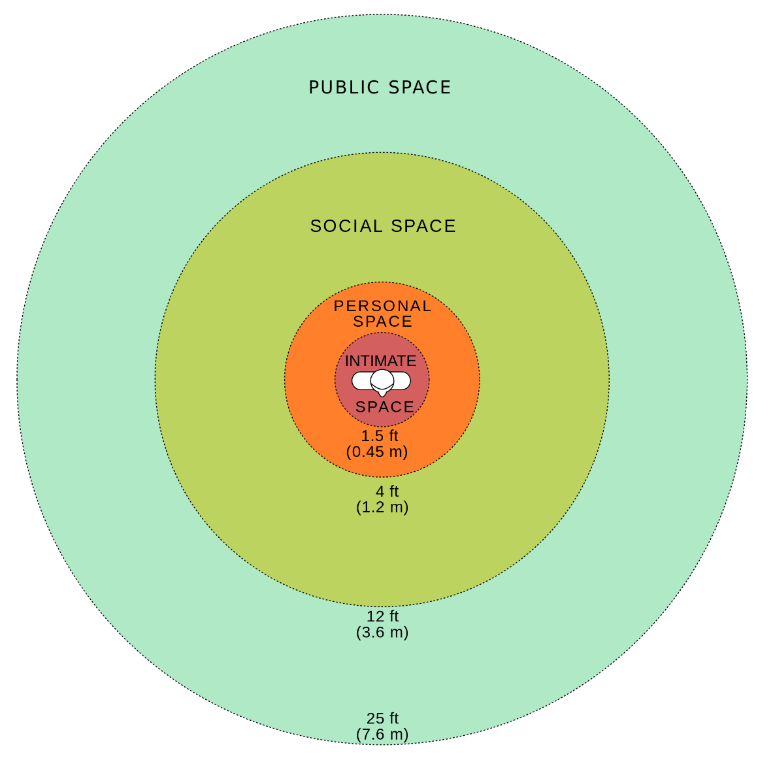
Proxemics (Space language)
To communicate while keeping a distance is called proxemics.
The amount of distance we need and the amount Of space we perceive as belonging to us is influenced by a number of factors including social norms, situational factors, personality characteristics and level of familiarity

Slide 39
Symbolic Communication
It involves the verbal and nonverbal symbolism to convey meaning. Art and music are forms of symbolic communication used by nurses to facilitate understanding and healing for patients.

Slide 40
METACOMMUNICATION:
It is 'communication about communication' so that the deeper 'message within a message' can be uncovered and understood. When a patient tells the nurse that he is cool to undergo surgery with his body rigid and sharp voice, a nurse can interpret that he is anxious as evidenced by the body language.

Slide 41
Paraverbal Messages
Paraverbal communication refers to the messages that we transmit through the tone, pitch and pacing of our voices
Example:
I didn’t say you were stupid
I didn’t say you were stupid
I didn’t say you were stupid

Slide 42
The Communication Process

Slide 43
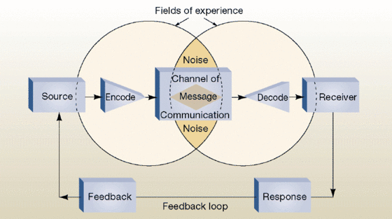
THE COMMUNICATION PROCESS
In the communication process,
A sender(encoder) encodes a message and then using a medium/channel sends it to the receiver (decoder), who decodes the message and after processing information, sends back appropriate feedback/reply using a medium/channel

Slide 44
Components of the communication Process
Context
Sender / Encoder
Message
Encoding (Communication symbol)
Medium
Recipient / Decoder
Decoding
Feedback
Notes:
Context - Communication is ffected by the context in which it takes place. This context may be hysical, social, chronological or cultural. Every communication proceeds with context. Sender / Encoder - Sender / Encoder is a person who sends the message. A sender makes use of symbols (words or graphic or visual aids) to convey the message and produce the required response.
Message - Message is a key idea that the sender wants to communicate. It must be ensured that the main objective of the message is clear. Encoding (Communication symbol) - The process of conversion of subject matter into symbols is called encoding. The message or subject matter of any communication is always abstract and intangible. Transmission of message requires use of certain symbols.
Medium - Medium is a means used to exchange / transmit the message For instance - Written medium is chosen when a message has to be conveyed to a small group of people, while an oral medium is chosen when spontaneous feedback is required from the recipient as misunderstandings are cleared then and there. Recipient / Decoder - Recipient / Decoder is a person for whom the message is intended / aimed / targeted. The degree to which the decoder understands the message is dependent upon various factors such as knowledge of recipient, their responsiveness to he message, and the reliance of encoder on decoder.
Decoding — It is the process of translation of an encoded message into ordinary understandable language. Receiver converts the symbols, words or signs received from the sender to get the meaning of the message.
Feedback - Feedback is the main component of communication process as it permits the sender to analyze the efficacy of the message. It helps the sender in confirming the correct interpretation of message by the ecoder. Feedback may be verbal (through words) or non-verbal (in form of smiles, sighs, etc.). It may take written form also in form of memos, reports, etc.

Slide 45
Communication Models
Linear Model
Interactive Model
Information is transmitted from sender to receiver via a channel without the sender receiving any feedback
There is feedback. The sender is able to know that the message was received.

Slide 46
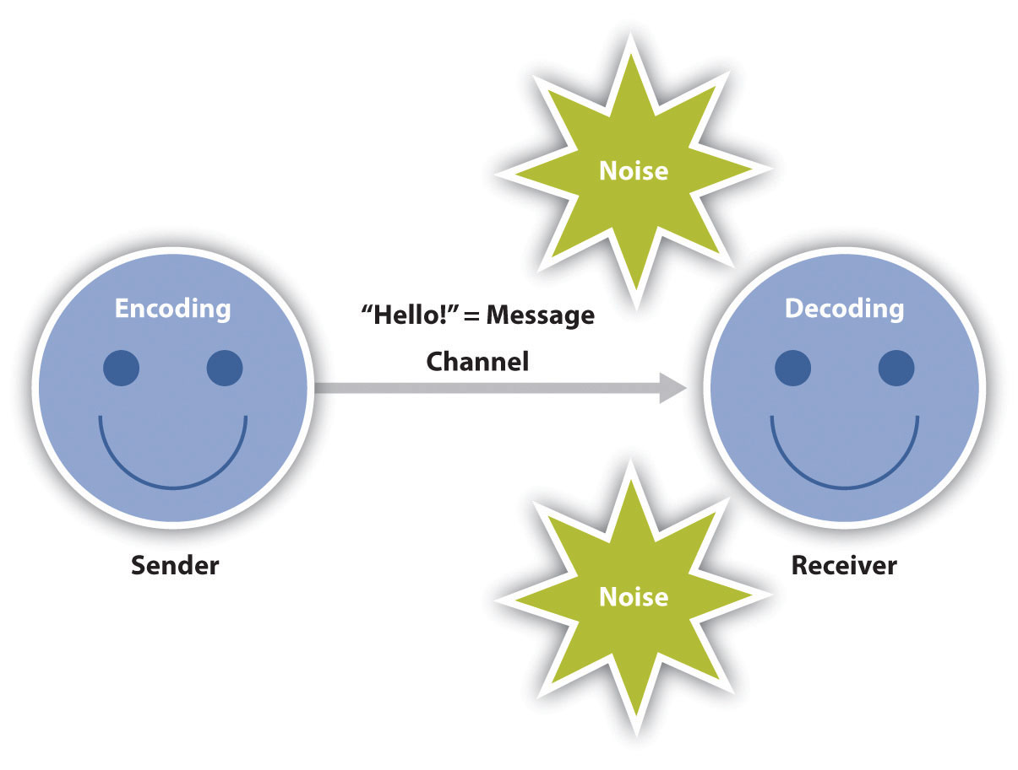
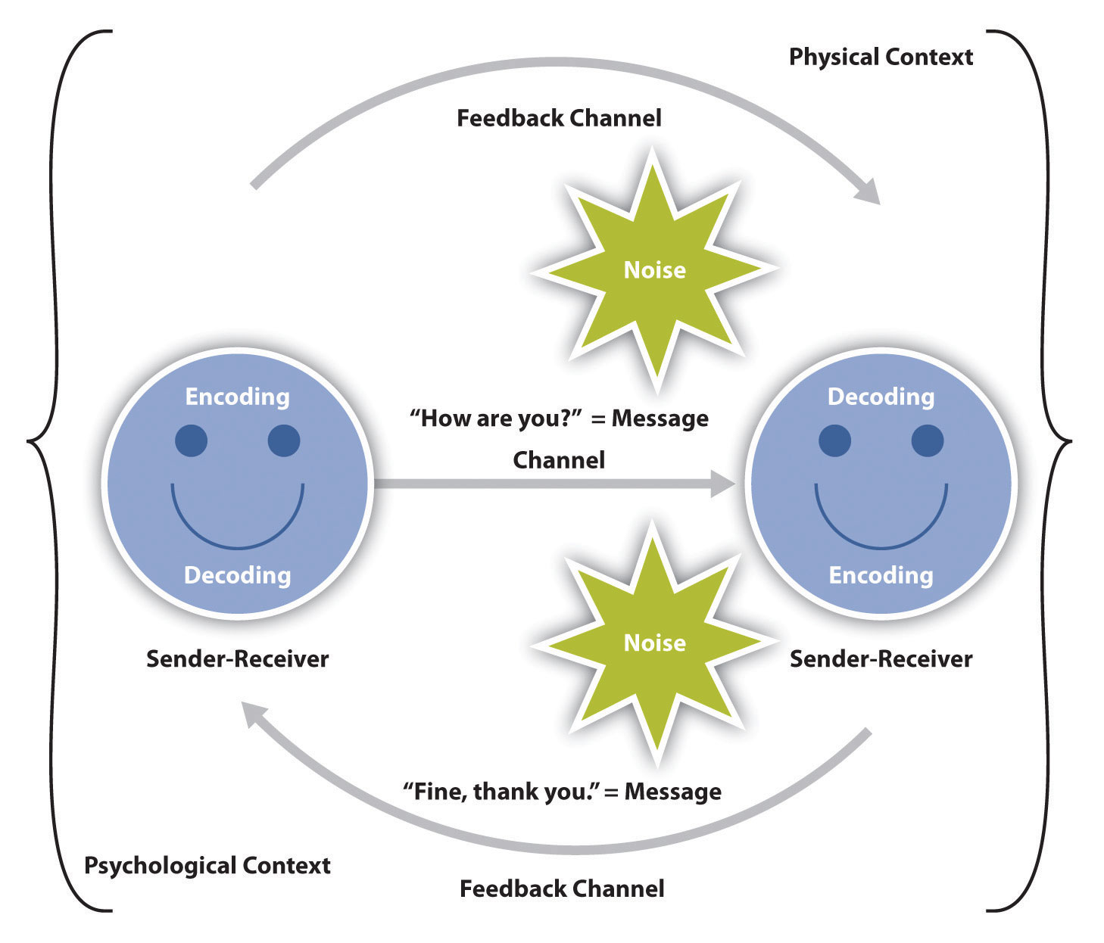
Communication Models
Linear Model
Interactive Model

Slide 47
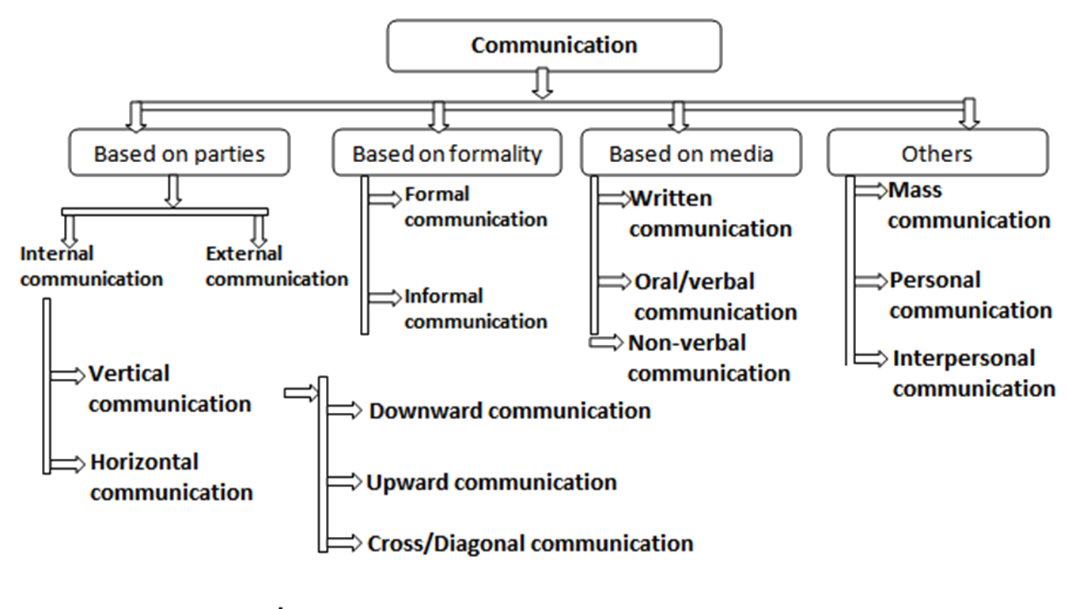
Communication types based on style and purpose

Slide 48
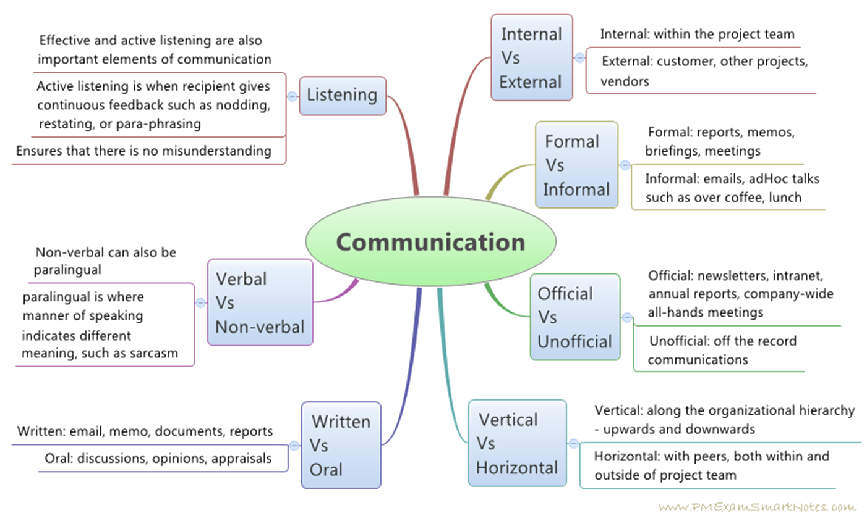
COMMUNICATION SUMMARY

Slide 49
What Makes an Effective Communicator

Slide 50
What is Effective Communication
Effective Communication is a two way process — sending the right message and to the right person.
It is important to know the psychology of the people/audience you are interacting with for communication to be effective.
For communication to be effective it is necessary to know the circumstances of the counter entity.
Effective communication includes all the aspects of visual, auditory and kinesthetic language to appeal the listener. Effective communication is the communication which produces intended or desired result

Slide 51
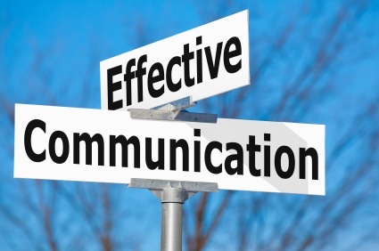
Uses of effective communication
Effective communication helps to understand a person or situation in a better way.
It enables us to solve the differences, build trust and respect in the organization.
Sometimes our message is misunderstood or we misunderstand the received message, effective communication helps us to resolve problems with both points of view.
Effective communication helps us to connect well with kids, spouse, boss, colleagues, etc.
It helps us in decision making.

Slide 52
7Cs of Communication
Completeness
Consciseness
Consideration
Clarity
Concreteness
Courtesy
Correctness

Slide 53
Completeness
The information conveyed in the message should be complete for the communication to be effective.
The sender must take into consideration the receiver's mind set and convey the message accordingly.
Complete communication enhances the reputation of the organization.
Complete information always gives additional information wherever required, it leaves no question in the minds of the receiver.
Complete information helps in better decision making as it serves all the desired and crucial information.
Complete information persuades the audience.

Slide 54
Conciseness
Conciseness means communicating what you want to convey in least possible words.
Conciseness is a necessity for effective communication.
Concise communication provides short and essential message in limited words.
Concise message is more appealing and comprehensive to the audience.
Concise messages are non repetitive in nature.

Slide 55
Effective communication must take audience Into consideration by knowing the viewpoints, back ground, mindset, educational level, etc.
Consideration implies 'stepping into the shoes of others.
Consideration ensures that the self respect of the audience is maintained and their emotions are not harmed.
Consider the needs and requirements of the audience to achieve effective communication.
Consideration

Slide 56
Clarity
Clarity implies emphasizing on a specific goal or objective at a time, rather than trying to move away from track.
Clarity helps to understand the message easily.
Complete clarity of thoughts and ideas enhances the meaning of message.
Clarity comes with the use of exact, appropriate and concrete words.

Slide 57
Concrete communication implies being particular and clear rather being fuzzy and general.
Concrete communication shows good level of confidence.
Concrete information helps to strengthen the reputation of the organization.
Concrete information cannot be misinterpreted.
Concreteness

Slide 58
Courtesy
Courtesy means being polite, kind, judicious, enthusiastic and convincing.
Courtesy is an important element of effective communication.
Courtesy reflects the nature and character of the sender of the message.
It is the same as give respect and then expect the same. Courtesy is not at all bias in nature.

Slide 59
Correctness in the communication implies that the correct information is conveyed through message.
Correct communication boosts up the confidence level of the sender.
Correct information has greater impact on the audience.
Free from grammatical errors and use of appropriate and correct language.
Correct information includes the precision and accurateness of facts and figures used in the message.
Correctness

Slide 60
BARRIERS IN COMMUNICATION

Slide 61
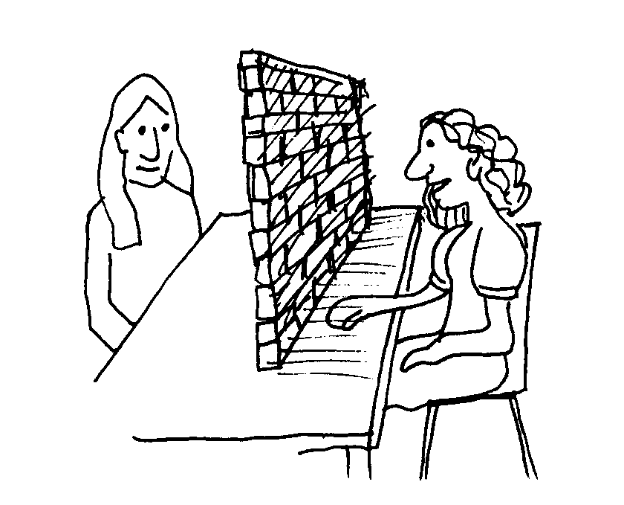
Organizational Barriers
These barriers arise when duties and line of authority are not clearly defined.
Various types of organizational barriers are:
Policy
Rules and regulations
Facilities
Complex organization
Status and position

Slide 62
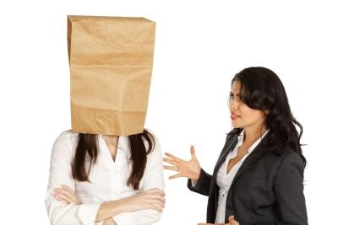
Psychological Barriers
Poor pronunciation.
Confused thinking.
Communication overload.
Attitude.
Fear and anxiety.
Suspicious, jealousy, anger.
Resentment, antagonism and prejudices.
Lack of interest and lack of listening.

Slide 63
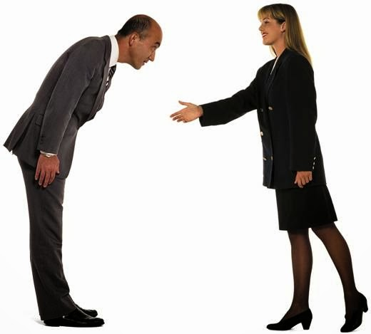
Physical and Cultural Barriers:
Physical Health
Poor Hearing
Distances
Cultural Habits
Social Norms

Slide 64
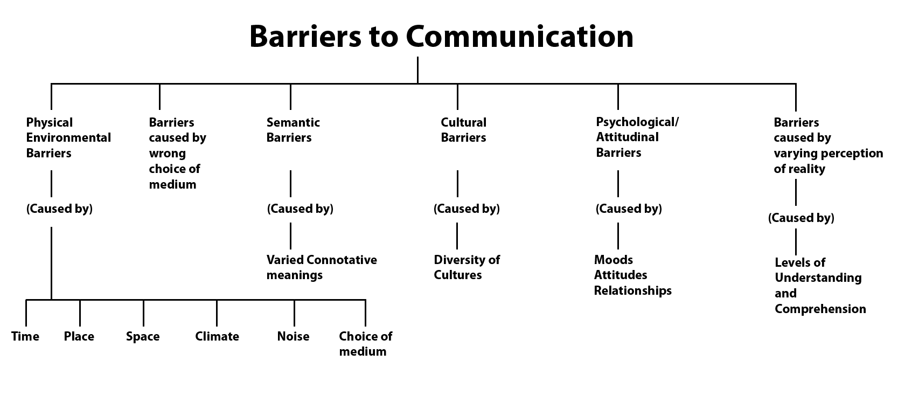

Slide 65
Conclusion:
Oral
Presentation
Audience Awareness
Critical Listening
Body Language
Written
Academic Writing
Revision and Editing
Critical Reading
Presentation of Data
Nonverbal
Audience Awareness
Personal Presentation
Body Language

Slide 66


